Slide 1
Building ML model using Spark
Suvam Mondal (A21035)

Slide 2
Overview
Goal of the Project
Source and Description of Data
Tools used
Conclusions Drawn

Slide 3
Goal of the Project
This section explains the problem statement and the intended objective of the project

Slide 4
Background
One of the most common marketing strategy in Banking sector is direct marketing campaigns through phone calls
It is a form of advertising that allows organizations to communicate directly with customers to offer their services based on the client’s existing bank profile
Direct marketing campaigns help banks to cross sell or upsell products
Dataset containing the details of existing customers of a Portuguese banking institution is available. The various information regarding the customers as well as whether they have availed a term loan or not is also available.

Slide 5
Business Goal and Project Objective
Business Goal
To build a list of target customers who are likely to subscribe a term deposit. The more targeted the campaigns, the more successful they are likely to be
Project Objective
To build a ML model to predict whether an existing customer of a bank will subscribe a term deposit or not so that the banks can arrange a better management of available resources by focusing on the potential customers “predicted” by the classifier .
This will help the bank to design a more efficient and precise campaign strategy to reduce the costs,improve the profits and customer satisfaction

Slide 6
Source and Description of the data
This section describes details of the dataset

Slide 7
Dataset: Description
Data Set
The dataset is related with direct marketing campaigns of a Portuguese banking institution. The dataset consists of details 45211 customers of the bank.
Source: uci machine learning repository
Output variable (desired target):
y - has the client subscribed a term deposit? (binary: 'yes', 'no')
Feature Variables:
A total of 20 variables have been identified

Slide 8
Feature Variables
Sl # | Variable Name | Remarks
1 | Age | Numeric
2 | Housing | Has housing loan? (categorical: 'no', 'yes', 'unknown')
3 | Job | Type of job (categorical: 'admin.', 'blue-collar', 'entrepreneur', 'housemaid', 'management', 'retired', 'self-employed', 'services', 'student', 'technician', 'unemployed', 'unknown')
4 | Marital | Marital status (categorical: 'divorced', 'married', 'single', 'unknown' ; note: 'divorced' means divorced or widowed)
5 | Education | (categorical: 'basic.4y', 'basic.6y', 'basic.9y', 'high.school', 'illiterate', 'professional.course', 'university.degree', 'unknown')
6 | Default | Has credit in default? (categorical: 'no', 'yes', 'unknown')
7 | Loan | Has personal loan? (categorical: 'no', 'yes', 'unknown')

Slide 9
Feature Variables
Sl # | Variable Name | Remarks
8 | Contact | contact communication type (categorical: 'cellular','telephone')
9 | Month | last contact month of year (categorical: 'jan', 'feb', 'mar', …, 'nov', 'dec')
10 | Dayofweek | last contact day of the week (categorical: 'mon','tue','wed','thu','fri')
11 | Duration | last contact duration, in seconds (numeric)
12 | Campaign | number of contacts performed during this campaign and for this client (numeric, includes last contact)
13 | Pdays | number of days that passed by after the client was last contacted from a previous campaign (numeric; 999 means client was not previously contacted)
14 | Previous | number of contacts performed before this campaign and for this client (numeric)

Slide 10
Feature Variables
Sl # | Variable Name | Remarks
15 | Poutcome | outcome of the previous marketing campaign (categorical: 'failure','nonexistent','success')
16 | Emp.var.rate | employment variation rate - quarterly indicator, it defines as a measure of the extent to which available labour resources (people available to work) are being used. (numeric)
17 | Cons.price.idx | consumer price index - monthly indicator (numeric), it expresses the change in the current prices of the market basket in terms of the prices during the same month in the previous year
18 | Cons.conf.idx | consumer confidence index - monthly indicator
19 | Euribor3m | euribor 3 month rate - daily indicator (numeric), it is the interest rate at which a selection of European banks lend one another
20 | Nr.employed | number of employees - quarterly indicator (numeric)

Slide 11
Tools and Techniques Used
This section lists the tools and techniques used

Slide 12
Tools Used
Exploratory data Analysis(EDA): Spark MLlib Statistics Library
Summary Statistics
Correlation of Variables
Machine Learning model used: Spark MLlib Logistic Regression Library
Model Building
Prediction
Prediction after removing correlated variables
Hypothesis Testing: Prediction after removing insignificant variables after a chi square test

Slide 13
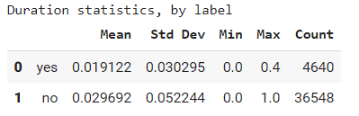
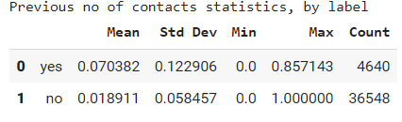
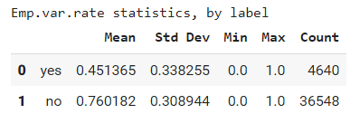
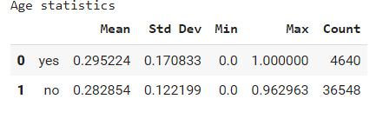
EDA -Summary Statistics
The categorical variables are removed from the dataset in order to make the dataset dense
A summary statistics of all the 9 numerical variables are done by target variable label (‘Yes’’ and ‘No’)

Slide 14
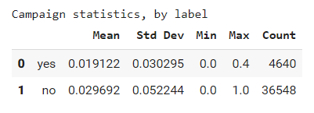
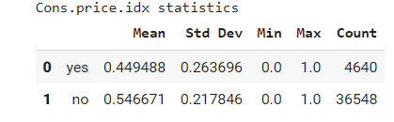
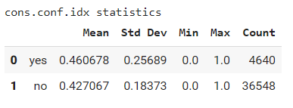
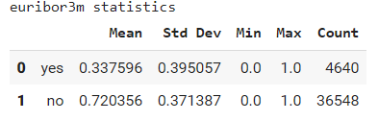
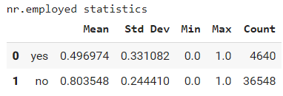
EDA - Summary Statistics(contd:)

Slide 15
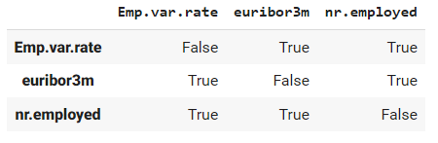
EDA - Correlation of Variables
A sample of the dataset was taken and correlation between all the numerical variables was checked using Spearman’s correlation method.
Three of the variables were found highly correlated: Emp.var.rate, euribor3m, nr.employed

Slide 16
Model Building and Prediction
A dataset of size 41188 was trained and a dataset of size 4119 was used for testing
A data type ‘LabeledPoint was created , of which first element is label and second element is array of all features
Model ‘LogisticRegressionWithLBFGS’ imported using the library pyspark.mllib is used to train the training dataset
The model was fit on the testing dataset and the predictions were made
An accuracy of 90.92 is obtained and time taken for the execution is .619 seconds

Slide 17
Prediction after removing correlated variables
The three correlated variables Emp.var.rate, euribor3m, nr.employed are removed
The accuracy was checked again after fitting the model with the dataset containing the rest of the variables
Accuracy attained is 89.975%. Execution time: 3.564 seconds
We have lost quite a lot of accuracy and have not gained a lot of execution time during training.
So it is not a good step to remove correlated variables

Slide 18
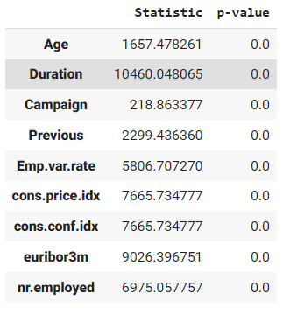
Hypothesis Testing: Chi Square Test and Prediction
Hypothesis testing is a powerful tool in statistical inference and learning to determine whether a result is statistically significant.
RDD of LabeledPoint was provided to Pearson's chi-squared (χ2) test. Real-valued features will be treated as categorical in each of its different values
After chi-squared (χ2) test it was noticed that all the variables are significant.
Hence none of the variables had to be removed
Logistic regression was run again in the test dataset with all the variables and the accuracy of 90.92 was obtained

Slide 19
Conclusion
Results obtained by running the logistic regression model in the train set and then fitting in the test set
Accuracy on data set with all numeric variables: 90.92%
Accuracy after removing correlated variables: 89.975%
Accuracy after running Chi square test: 90.92%
A logistic Regression model was built successfully with 90.92% accuracy, which can predict the list of existing customers (of a bank), who are willing to avail the ‘term deposit’ service

Slide 20
Thank You

